Slide 1
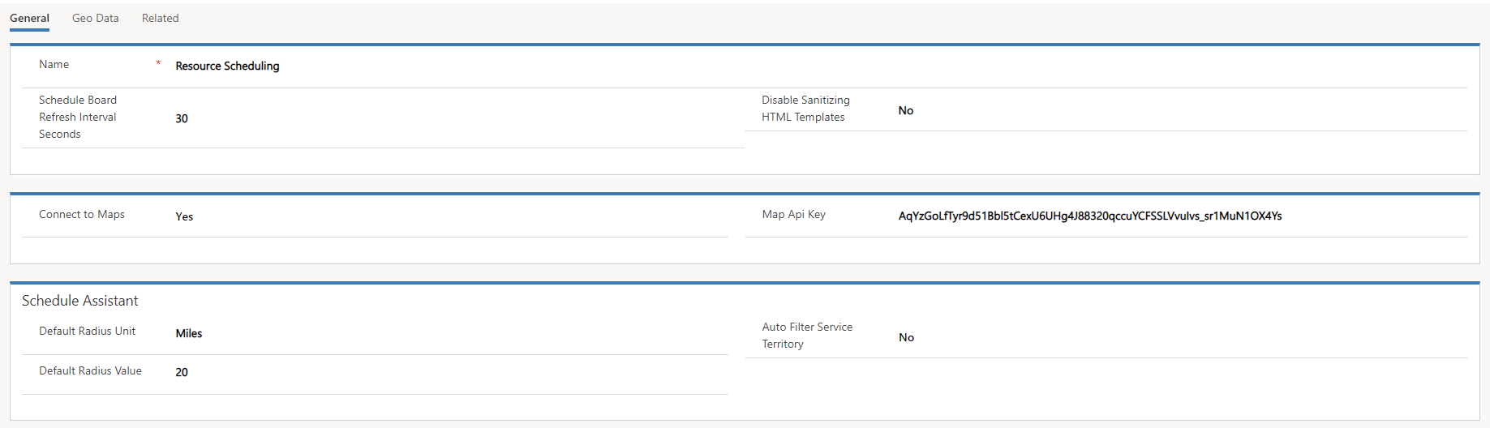
Will be set to no by default. Needs to be yes for mapping to be leveraged for scheduling.

Slide 2
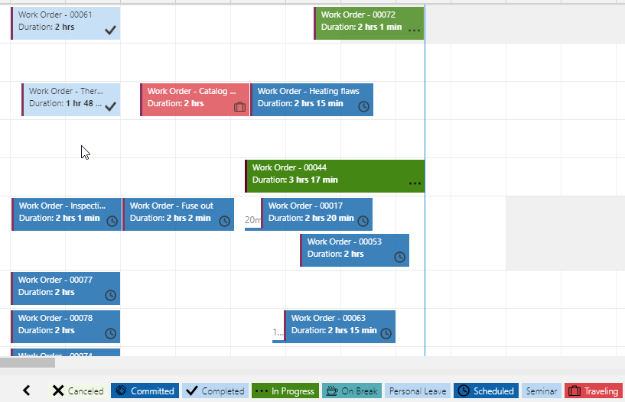

Slide 3
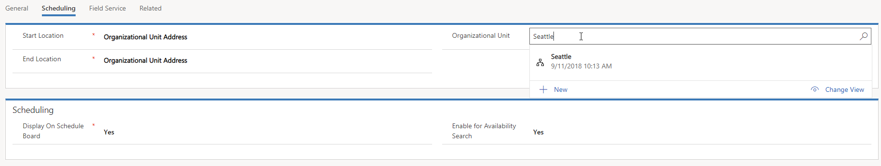
Used by schedule assistant to suggest resources, and to assist in route planning.
Make sure that

